Slide 1
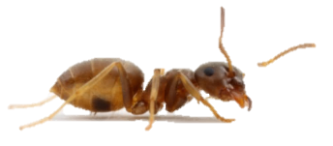
Value perception
in ants
1st visit – set reference point
Ant allowed onto setup, finds food
Mark ants with a dot of paint
Reference Sucrose solution
Very poor = 0.25 M
Poor = 0.5 M
Medium = 1 M
Good = 2 M
Ant colony

Slide 2
Value perception
in ants
1st visit – set reference point
Ant returns to nest to give her food away
Reference Sucrose solution
Very poor = 0.25 M
Poor = 0.5 M
Medium = 1 M
Good = 2 M
Ant colony

Slide 3
Value perception
in ants
1st visit – set reference point
Reference food replaced by fixed food
Fixed sucrose solution
Always medium = 1 M
Reference Sucrose solution
Very poor = 0.25 M
Poor = 0.5 M
Medium = 1 M
Good = 2 M
Ant colony

Slide 4
Value perception
in ants
1st visit – set reference point
2nd visit – test value perception
Ant (expecting reference food) allowed back
Fixed sucrose solution
Always medium = 1 M
Ant colony

Slide 5
Value perception
in ants
1st visit – set reference point
2nd visit – test value perception
All ants got the same quality on the 2nd visit, but had different expectations. Does this affect their pheromone deposition?`
Measure pheromone deposition
Fixed sucrose solution
Always medium = 1 M
Ant colony

Slide 6
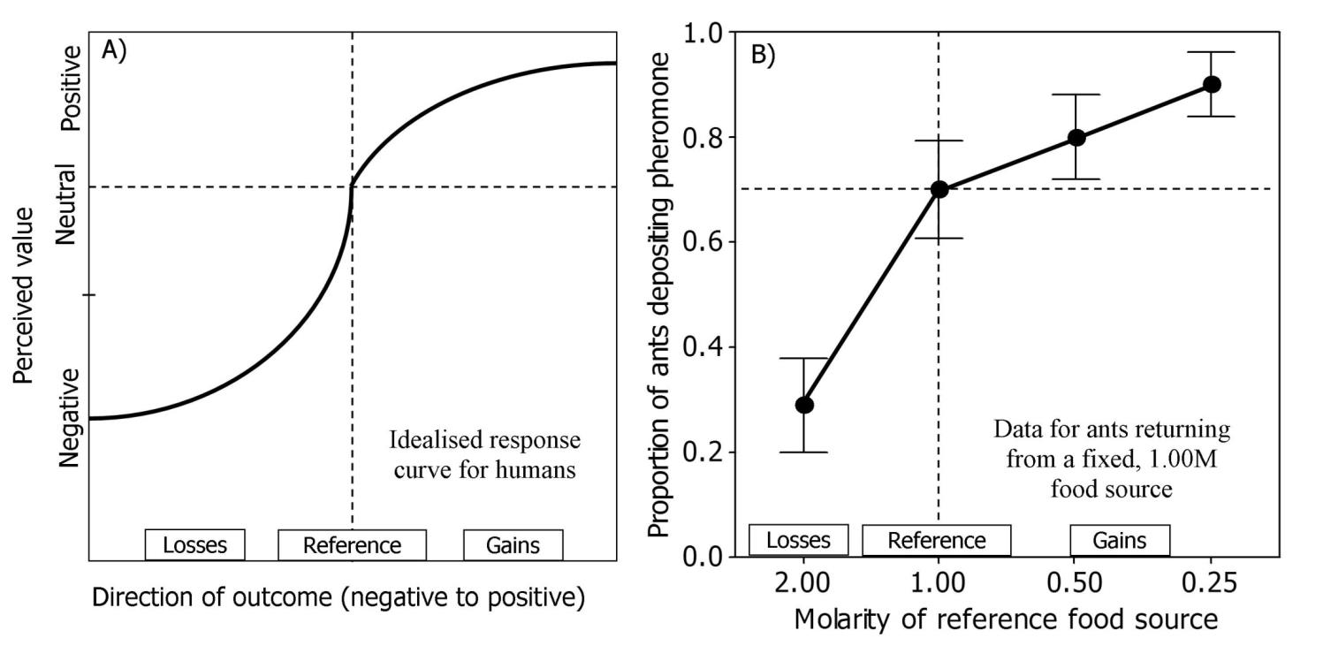
Value perception
Pilot study results
Idealised human response
Ant behaviour

